Slide 1
QSYS Process & Utilities Overview (Process & Utilities within the scope of ACC NF)
Daniel Berkowitz (MDB/ATS/ACR Unit)
Master Presentation

Slide 2
Mostly used for QPLANT Tender
SCK CEN Auxiliary Utilities
Document Reference and Navigation
Doc no. | Document Name | Document Description | SCK CEN Reference
1 | QSYS Masterplan Layout & Buildings | Master Presentation | SCK CEN/46467661
2 | MINERVA_4NT_862356_000_00_TOTALDOC.pdf | Realistic Building Views | SCK CEN/83474410
3 | MINERVA_4NT_862354_000_00_TOTALDOC.pdf | Masterplan | SCK CEN/84582975
4 | BA_Dienstgebouw SCK CEN_TB_N_01_T2_versie20092023_.PDF.pdf | Project Zone | SCK CEN/81504499
5 | BA_SAB 1_P_N_00_Gelijkvloers.pdf | CCB + Outside Gas Storage | SCK CEN/81503739
6 | BA_SAB 1_P_N_02_Dakplan.pdf | CCB roof | SCK CEN/81505370
7 | BA_SAB 1_S_N_AA_Snede AA_.pdf | CCB section | SCK CEN/81505150
8 | BA_SAB 1_S_N_BB_Snede BB_.pdf | CCB section | SCK CEN/81506075
9 | BA_SAB 1_G_N_GO_Gevelzicht Oost.pdf | CCB side view | SCK CEN/81506386
10 | BA_SAB 2_G_N_GW_Gevelzicht West.pdf | AUB side view | SCK CEN/81505064
11 | BA_SAB 1_P_N_00_Gelijkvloers.pdf | AUB | SCK CEN/81503739
12 | BA_SAB 2_S_N_CC_Snede CC_.pdf | AUB section | SCK CEN/81504370
13 | BA_SAB 1_S_N_BB_Snede BB_.pdf | AUB section | SCK CEN/81506075
14 | BA_SAB 2_P_N_02_Dakplan.pdf | AUB roof | SCK CEN/81504187
15 | BA_SAB 2_G_N_GN_Gevelzicht Noord.pdf | AUB side view | SCK CEN/81504188
16 | BA_SAB 2_G_N_GZ_Gevelzicht Zuid.pdf | AUB side view | SCK CEN/81506074
Taken from Building Master, still to adapt

Slide 3
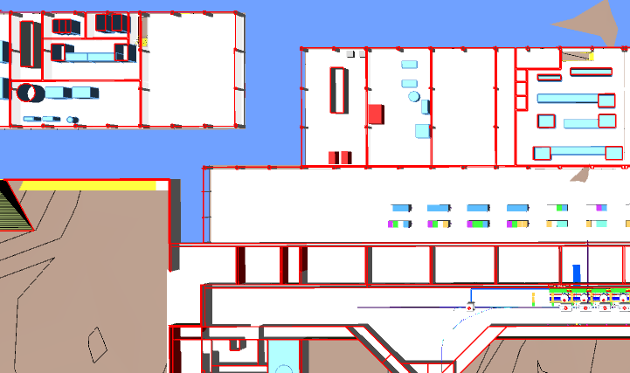
CCB
AUB.xxx
Cryoplant & Infrastructure
WCS
QRB
WSH
WSH
WSH
LTU
Cryo Backbone (QDB)
QLM
WPS
QVB
QVB
QVE
Cryomodules
QM
QM
QCELL

Slide 4
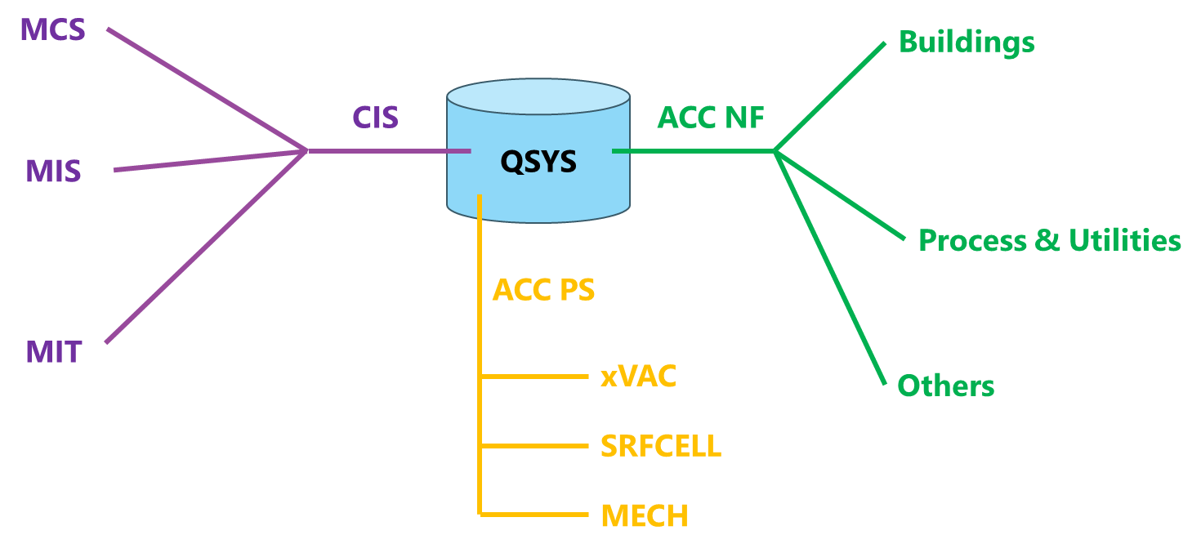
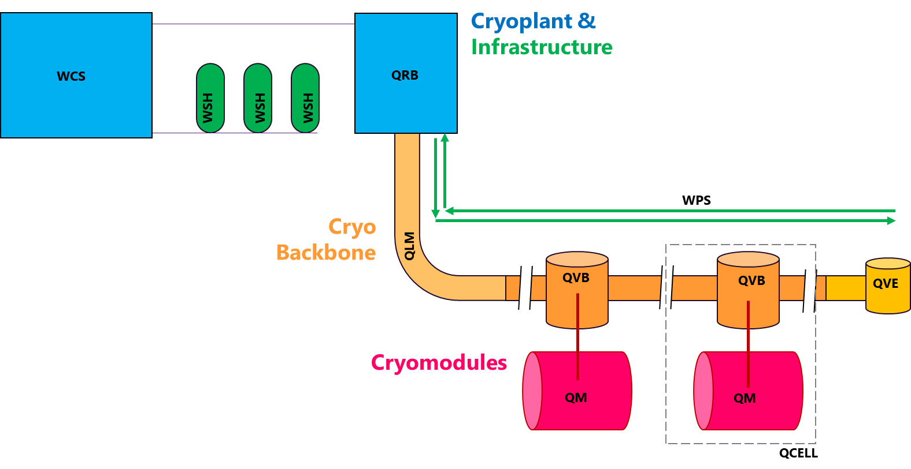
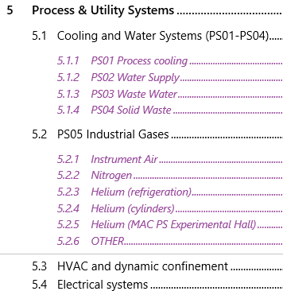
QSYS//ACC NF Interfaces – Process & Utilities
Overview:
“QSYS Process & Utilities Overview.ppt” ALX/90906480
PS02
PS05 Gases
PS05 Gases
water
oil
PS01 water
PS01 water
PS05 Gases
PS03
Power
HVAC
PS05 Gases
HV06
PS03
PS05 Gases
PS05 Gases
water
oil
PS05 Gases
Not in scope:
PS01 & PS03 for RFCELL’s CPLR

Slide 5
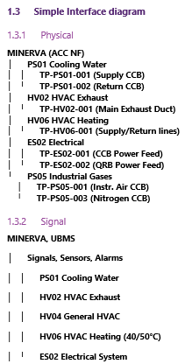
QPLANT Details
QPLANT // ACC NF interfaces (SCK CEN/91337678)
Document Title | NFS Responsible(s) | Link / Reference
QPLANT_Interface and Terminal Points_ACC NF.docx | PPO, JGE, GTH, JWI | SCK CEN/91337678
Interface List CRYO - ACC NF_test.xlsx | GTH / PS01/5, HV02/4/6, ES02 | SCK CEN/91339199
QPLANT_HV02 exhaust for KAEZER.docx | PPO | SCK CEN/91328192
QPLANT_PVPS_Interface.docx | PPO, JGE, GTH | SCK CEN/91333535
QPLANT_WCS_Kaezer.docx | PPO, JGE, GTH | SCK CEN/91326498
Process Systems (Cooling & Instrument Air)
PS01 – Cooling Water Supply & Return: Supplies cooling water to the compressor room; return lines provide process cooling feedback.
PS05 – Instrument Air & Nitrogen Supply: Provides instrument air for valve actuation and nitrogen for absorber regeneration.
HVAC Systems
HV02 – HVAC for Compressor Exhaust & Room Load: Manages room air, exhaust flow, and temperature control in the compressor room.
HV06 – Heat Recuperation: Provides a 40–50°C water supply/return loop for heat recovery from the process.
HV04 – QRB: (Optional/Additional) Specialized ventilation for the cold box.
Electrical Systems (ES02 – Low Voltage, up to 400 V)
Electrical Feeds for HPC: Main electrical feeds for HP compressors (HP1–HP4) including VFD control.
UPS Backup and Additional Feeds: Provides UPS backup for control systems, feeds for cold compressors, and other auxiliary electrical loads.

Slide 6
Utility interface requirements
Main Utilities and Auxiliaries provided by ACC NF
Cooling Water
1300 kW (1199 kW WCS HP; 57 kW PVPS; 44 kW QRB)
HVAC
134 kW (124 kW WCS – HV03; 10 kW QRB – HV02)
Heat Recovery (HV06)
850 kW (450 kW on TD)
Electricity
1526 kW (1397 kW WCS; 129 kW QRB)
Instrument Air (PS05)
120 m³/h (10 m3/h – WCS; 50 m3/h – LTU; )
Gaseous Nitrogen (PS05)
375 LPM (50 LPM - WCS; 50 LPM -QRB)
=NA.AA_BMA003 - Interface List CRYO - ACC NF.xlsx SCK CEN/48341616

Slide 7
Cooling and Water Systems

Slide 8
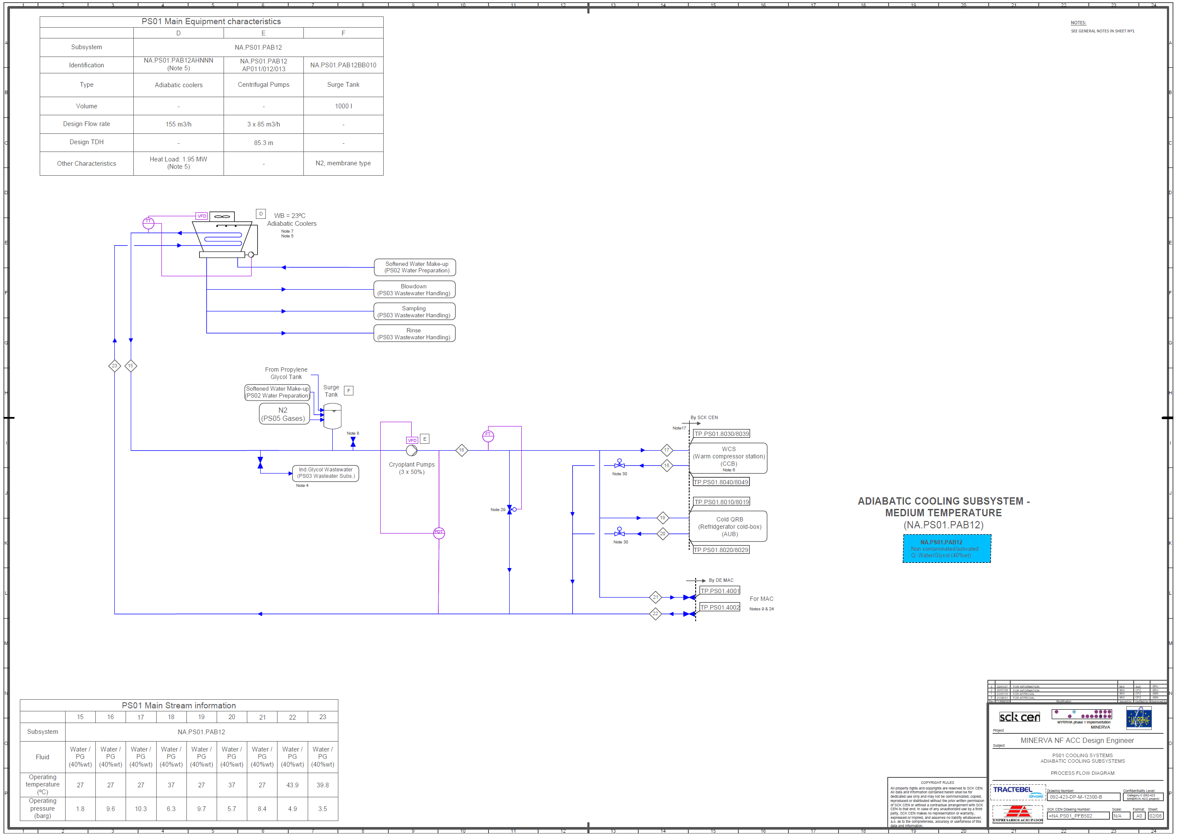
QSYS//PS01
QPLANT // PS01
WCS // PAB12
QRB // PAB12
→ QPLANT - WCS water cooling (IADR overview).pptx
=NA.PS01_PFB502 - PFD .pdf
PS01.PAB12
“Adiabatic cooling subsystem – medium temperature”

Slide 9
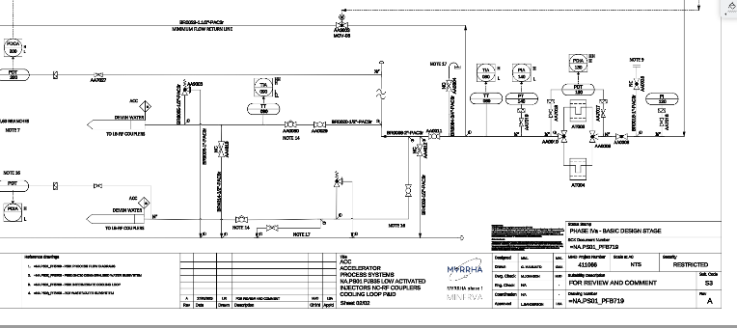
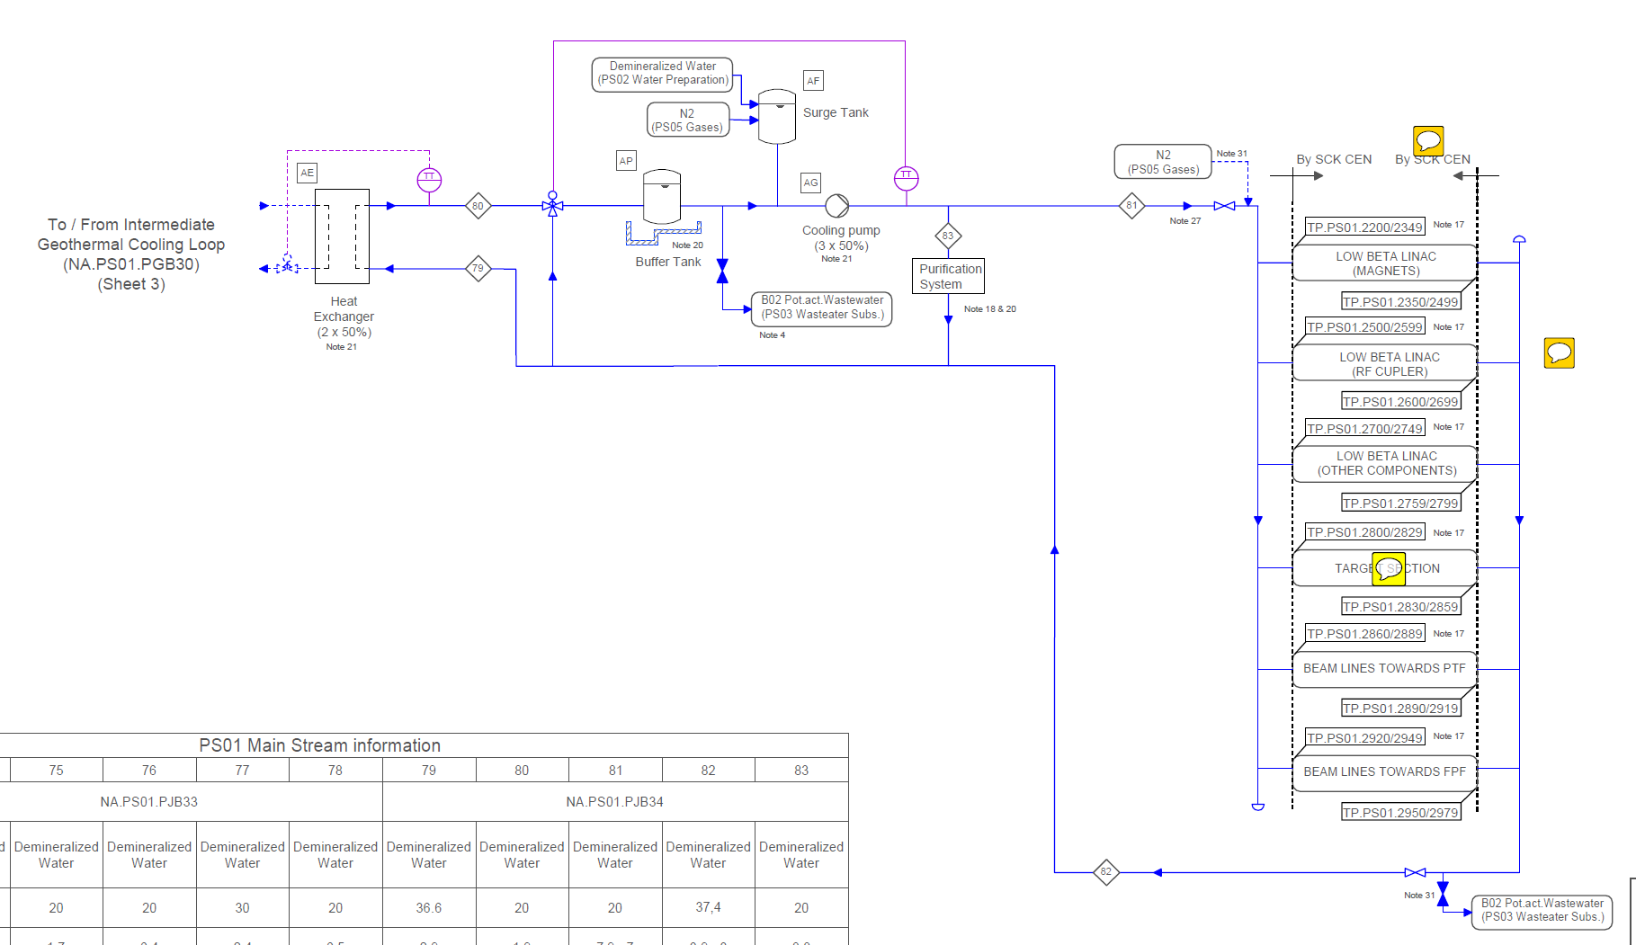

NOT QSYS Scope
(Shown only for reference)
RFCELL//PS01
RFCELL // PS01
CPLR // PJB35 (?)
=NA.PS01_PFB502 - PFD .pdf
PS01.PJB35 (?)
“LOW ACTIVATED
SC LINAC TUNNEL / CPLR”
New proposal
HX
CPLR-LB
NA.PS01.PGB30
NA.PS01.PJB35 (?)

Slide 10
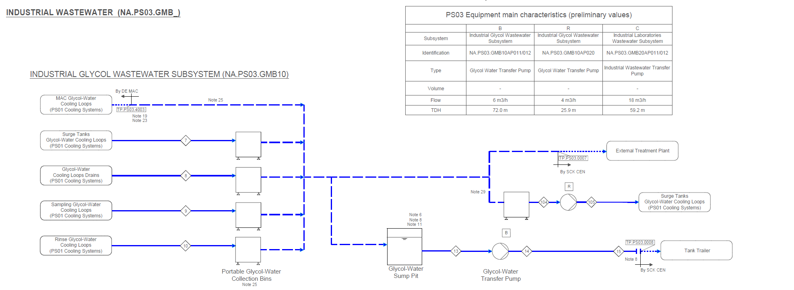
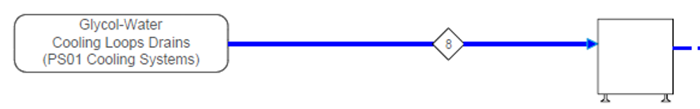
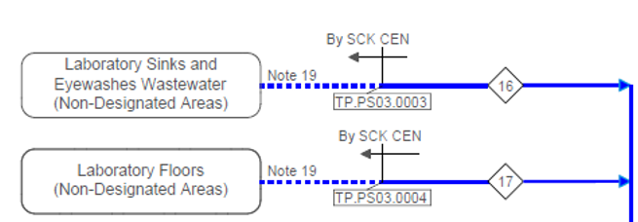
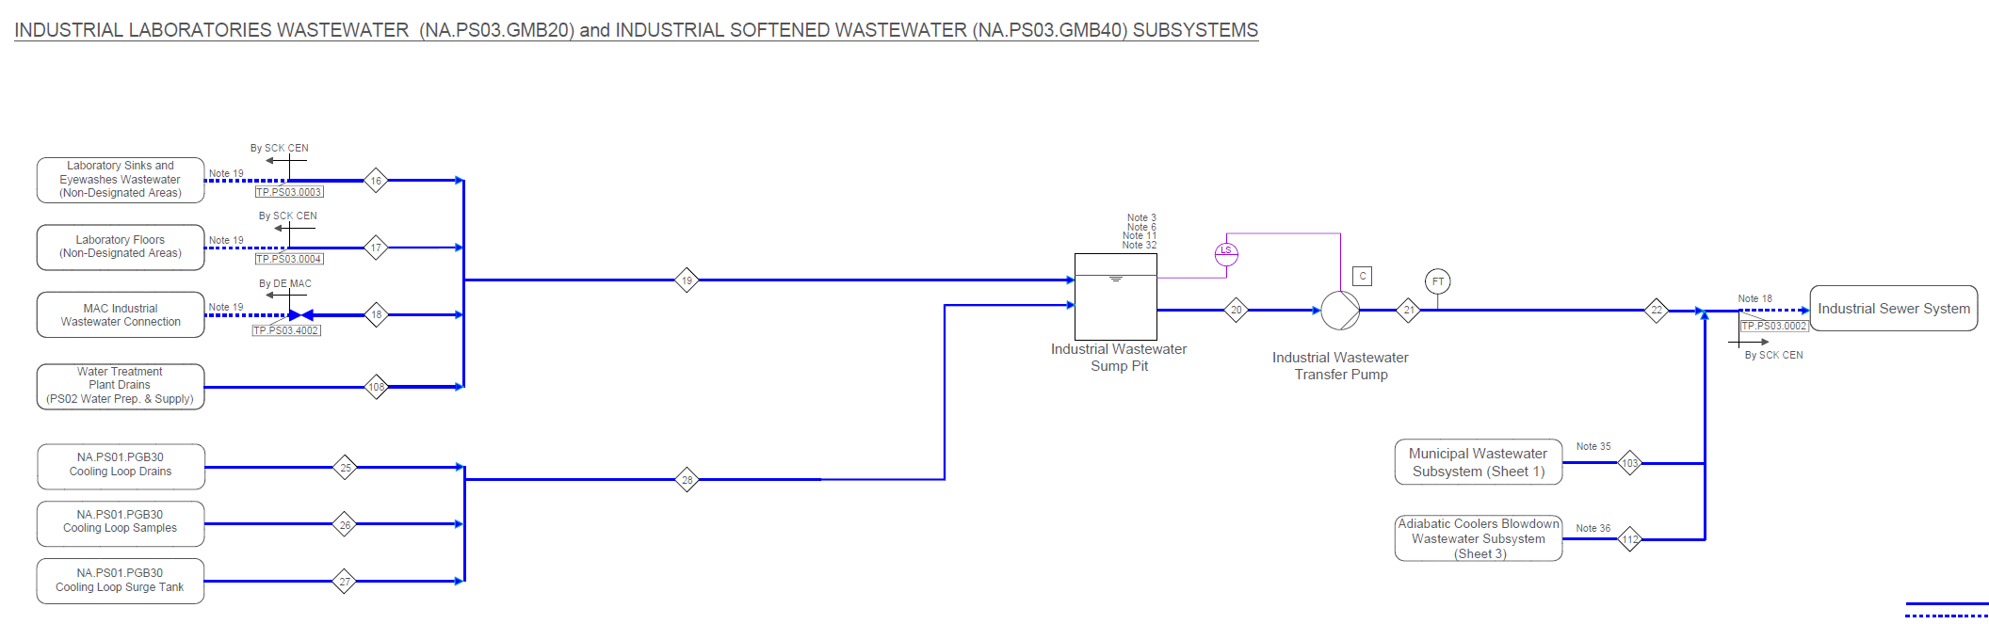
QSYS//PS03
QPLANT // PS03
WCS // GMB10
QRB // GMB10
WCS // GMB40
QRB* // GMB40
=NA.PS03_PFB502 R03_PFD.pdf
* For oil on QRB’s INVAC pumps
PS03.GMB10
“Industrial Glycol Wastewater Subsystem”
PS03.GMB40
“Industrial Laboratories Wastewater”

Slide 11
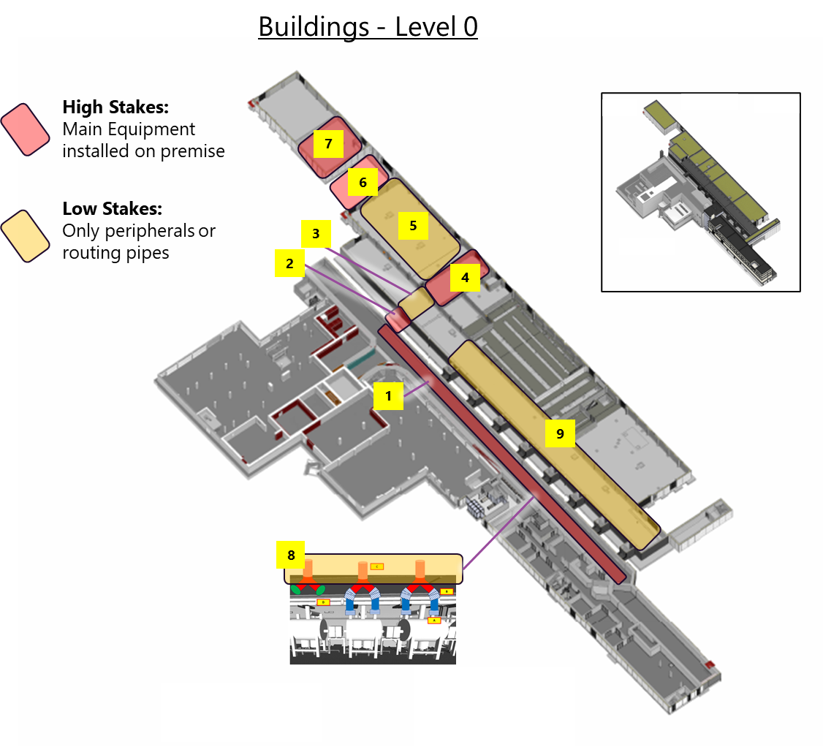
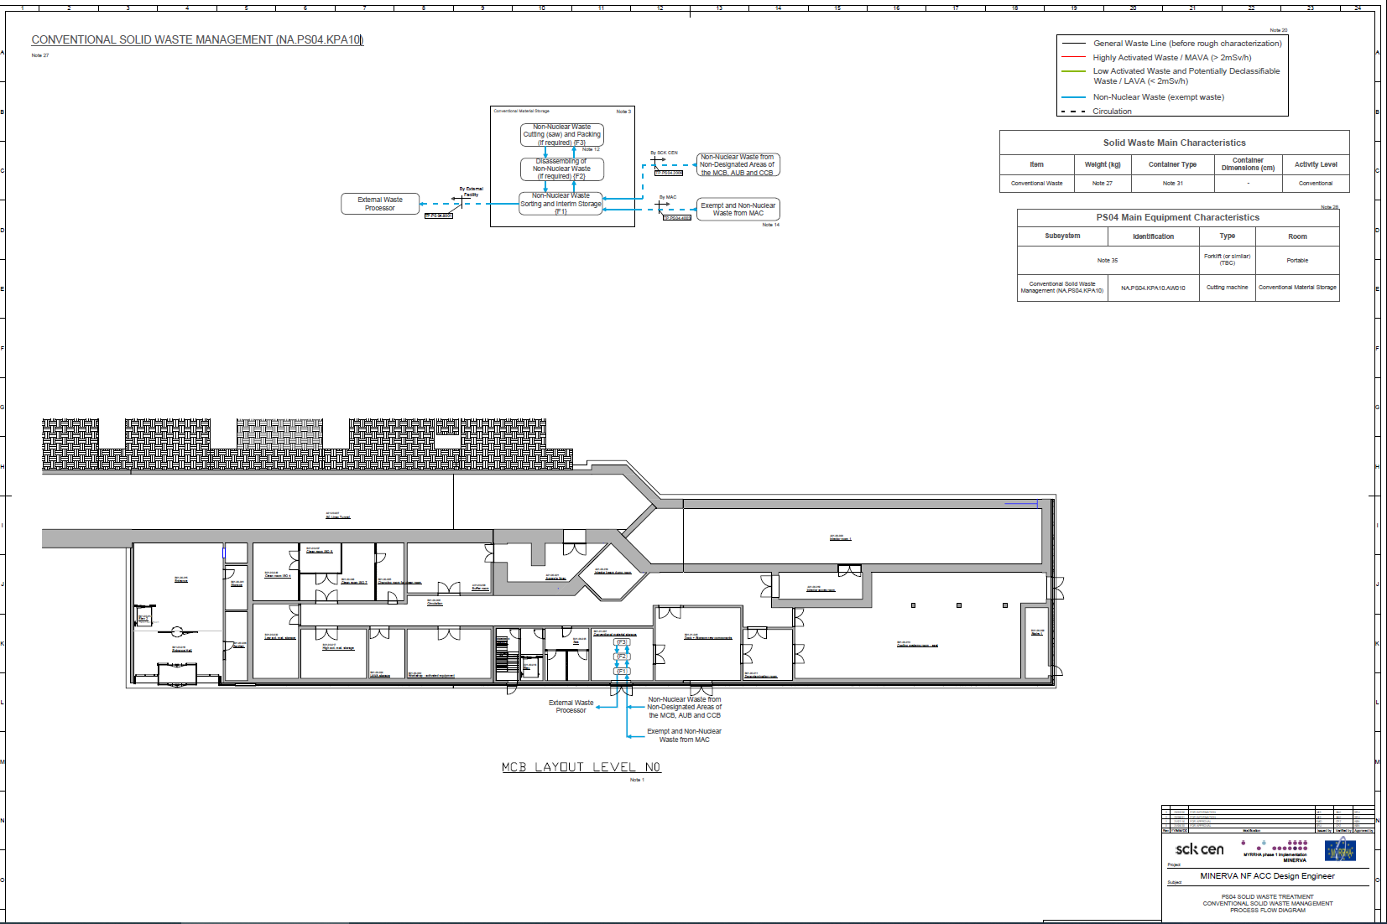
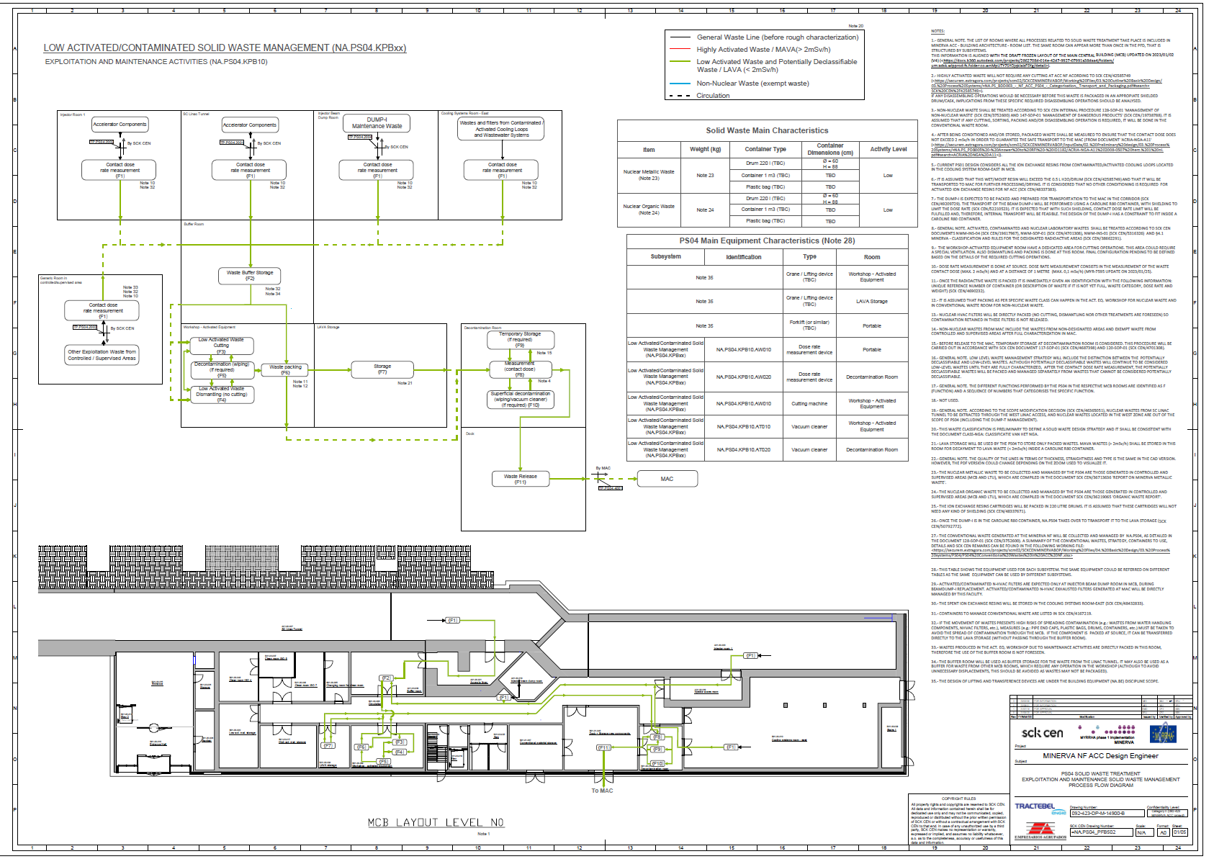
QSYS//PS04
QSYS // PS04
KPABxx, for equipment in
LTU (QB_1)
Chicane (QB_2)
Shielding (QB_3)
KPA10, for all remaining equipment
NA.PS04_PFB502 - PS04 PFD R02 Solid Waste Treatment Process Flow Diagram.pdf
KPA10
KPBxx
PS04.KPA10
“CONVENTIONAL SOLID WASTE MANAGEMENT”
PS04.KPBxx
“LOW ACTIVATED/CONTAMINATED SOLID WASTE MANAGEMENT”

Slide 12
QSYS//HV06
QPLANT // HV06
WCS // xxxx
→ QPLANT - WCS water cooling (IADR overview).pptx
HV06.xxxx
“[system name]”

Slide 13
Industrial Gases

Slide 14
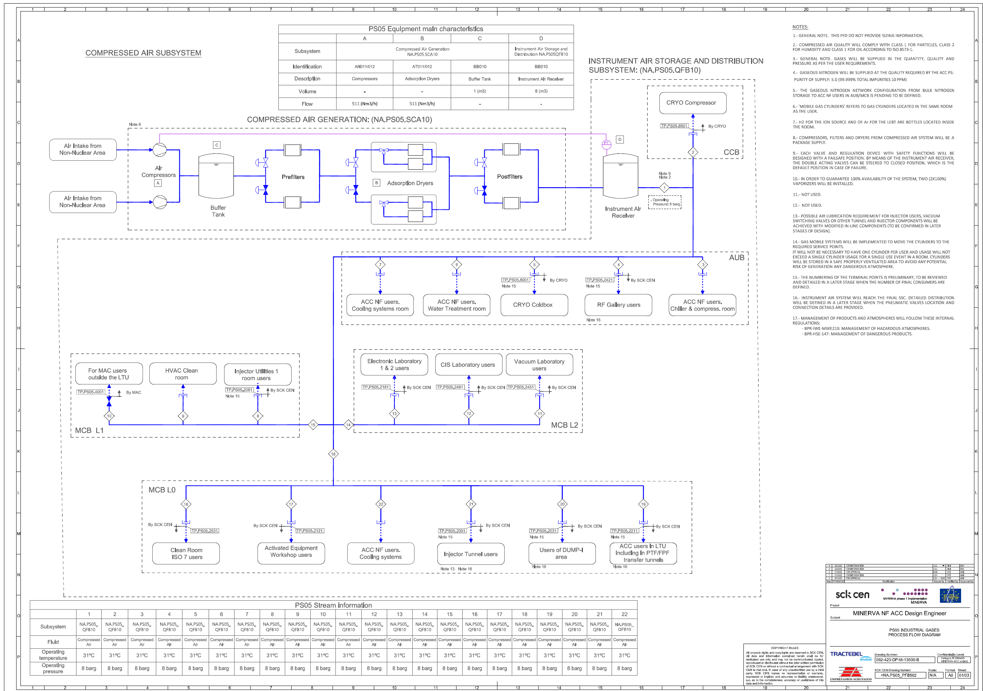
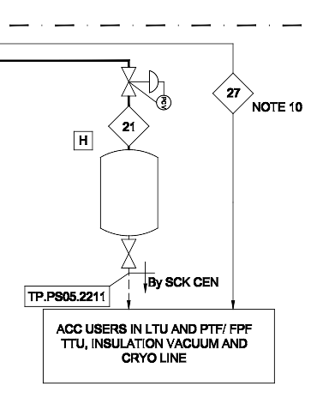
QSYS//PS05
QPLANT // PS05
WCS // QFB10
QRB // QFB10
QDIST // PS05
QLM // QFB10 ??
QVE // ??
QINFRA
WPS
WSH
QCELL
QM
??
=NA.PS05_PFB502 R04.pdf
PFD @BIM360
#21: T=31C, p=6bar
#27: T=31C, p=8.5bar
QFB10
“Instrument Air”

Slide 15
Copyright © SCK CEN - 2020
All property rights and copyright are reserved.
This presentation contains data, information and formats for dedicated use only and may not be communicated, copied, reproduced, distributed or cited without the explicit written permission of SCK CEN.
If this explicit written permission has been obtained, please reference the author, followed by ‘by courtesy of SCK CEN’.
Any infringement to this rule is illegal and entitles to claim damages from the infringer, without prejudice to any other right in case of granting a patent or registration in the field of intellectual property.
SCK CEN
Belgian Nuclear Research Centre
Studiecentrum voor Kernenergie
Centre d'Etude de l'Energie Nucléaire
Foundation of Public Utility
Stichting van Openbaar Nut
Fondation d'Utilité Publique
Registered Office:
Avenue Herrmann-Debrouxlaan 40 - 1160 BRUSSELS - Belgium
Research Centres:
Boeretang 200 - 2400 MOL - Belgium
Chemin du Cyclotron 6 - 1348 Ottignies-Louvain-la-Neuve - Belgium
15

Slide 16
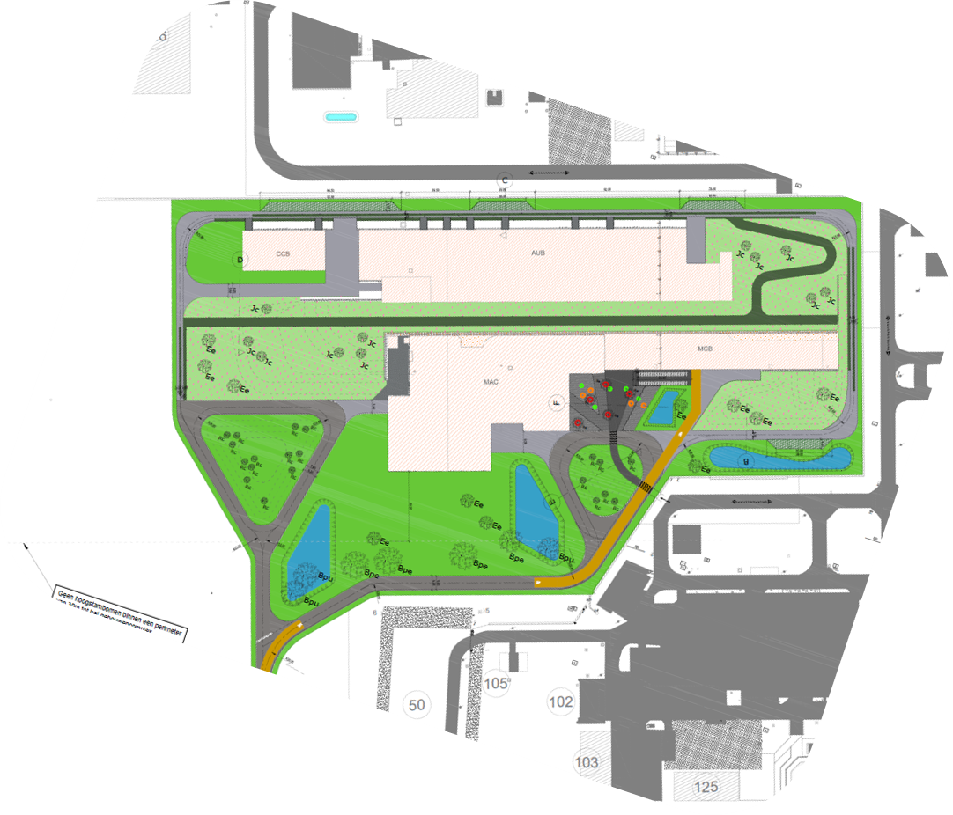
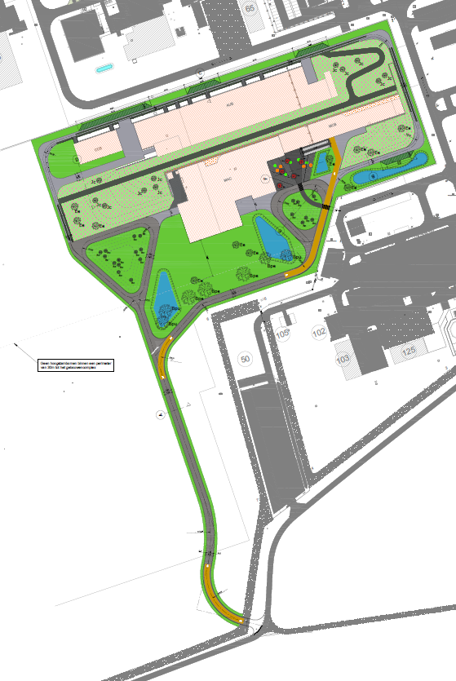
Masterplan - MINERVA
SCK CEN/84582975

